Slide 1
Cyber Security Audit & Standards
A cyber security audit is a comprehensive analysis and review of an organisation’s IT infrastructure. It detects vulnerabilities and threats, displaying weak links, and high risk practices. security audit aids you to find whether there is any number of cyber security challenges risks to your business and technological operations.
Why Security Audits Important ?:
Identify security problems and gaps, as well as system weaknesses.
Establish a security baseline that future audits can be compared with
Comply with internal organization security policies.
Comply with external regulatory requirements.
Determine if security training is adequate.
Identify unnecessary resources.

Slide 2
Cyber Security Audit & Standards
When is a Security Audit needed ?:
How often an organization does its security audits depends on the industry it is in, the demands of its business and corporate structures and no.of systems and applications that must be audited.
Organizations that handle a lot of sensitive data- such as financial services, & healthcare providers – are likely to audit more frequently.
Many companies will do a security audits at-least once or twice a year. But they can also be done monthly or quarterly.. Different departments may have different audit schedules depends on system, applications and data they use.
Internal | External
A business uses its own resources and internal audit department. | An outside organization is brought into conduct an audit
Internal audits are used when an organization wants to validate business system for policy and procedure compliances | External audits are also conducted when organization needs to conform it is conforming to industry standards or government regulations

Slide 3
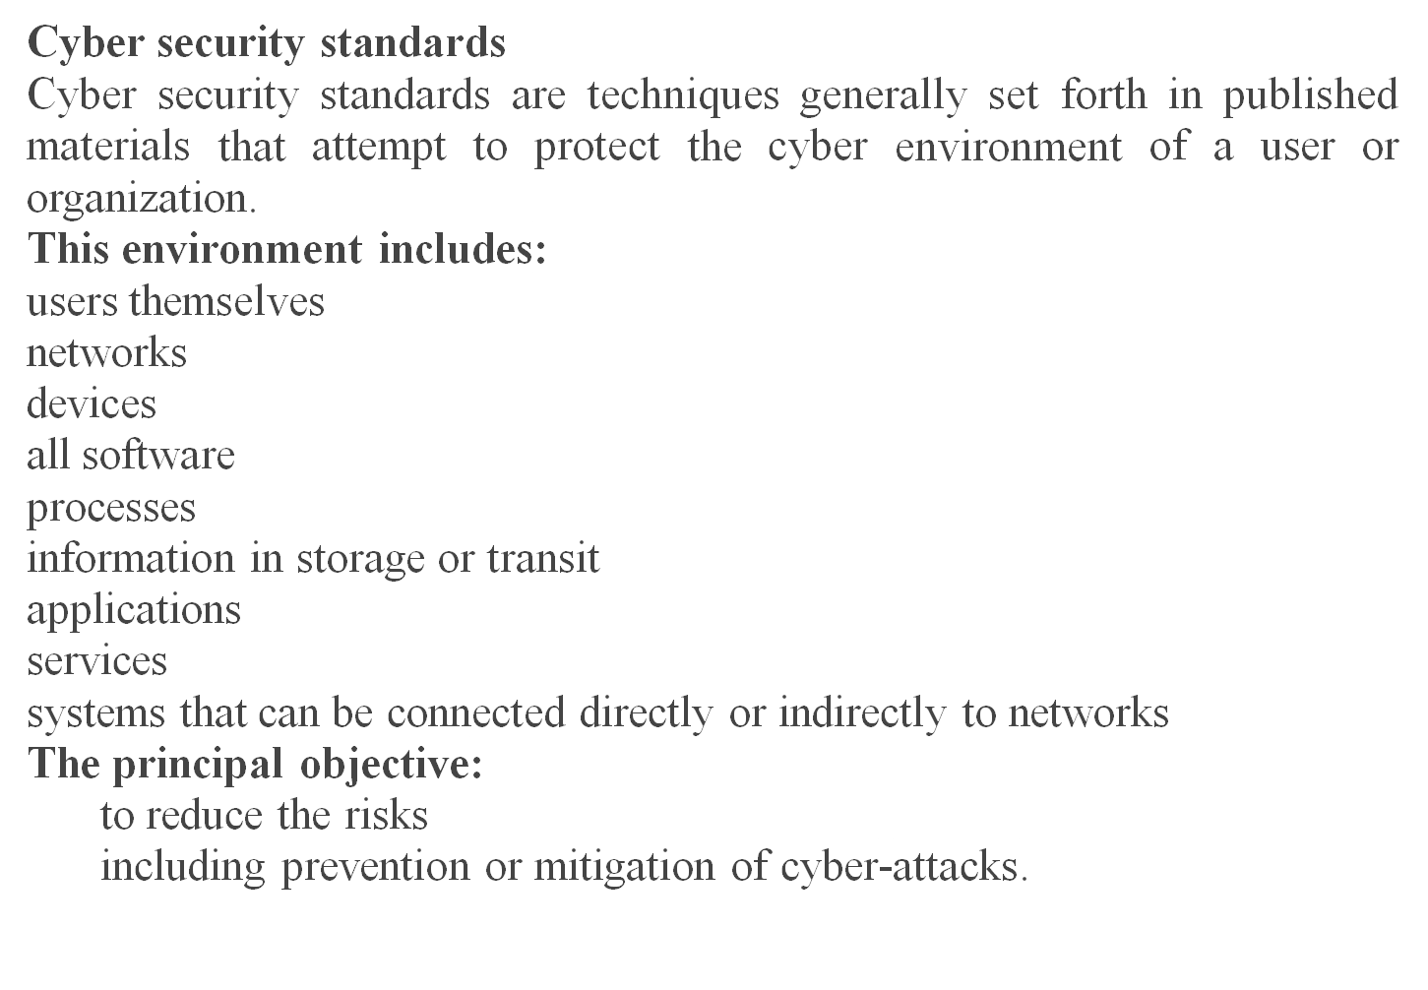
Cyber Security Standards

Slide 4
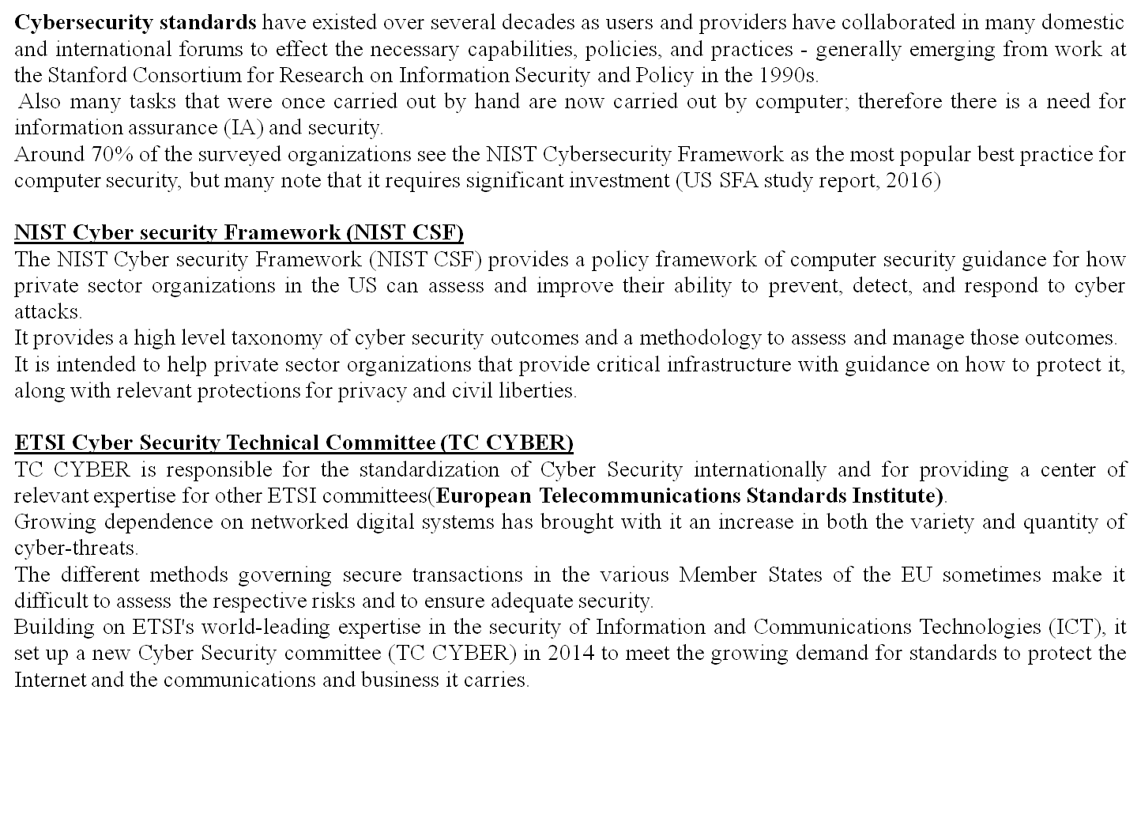
Cyber Security Standards

Slide 5
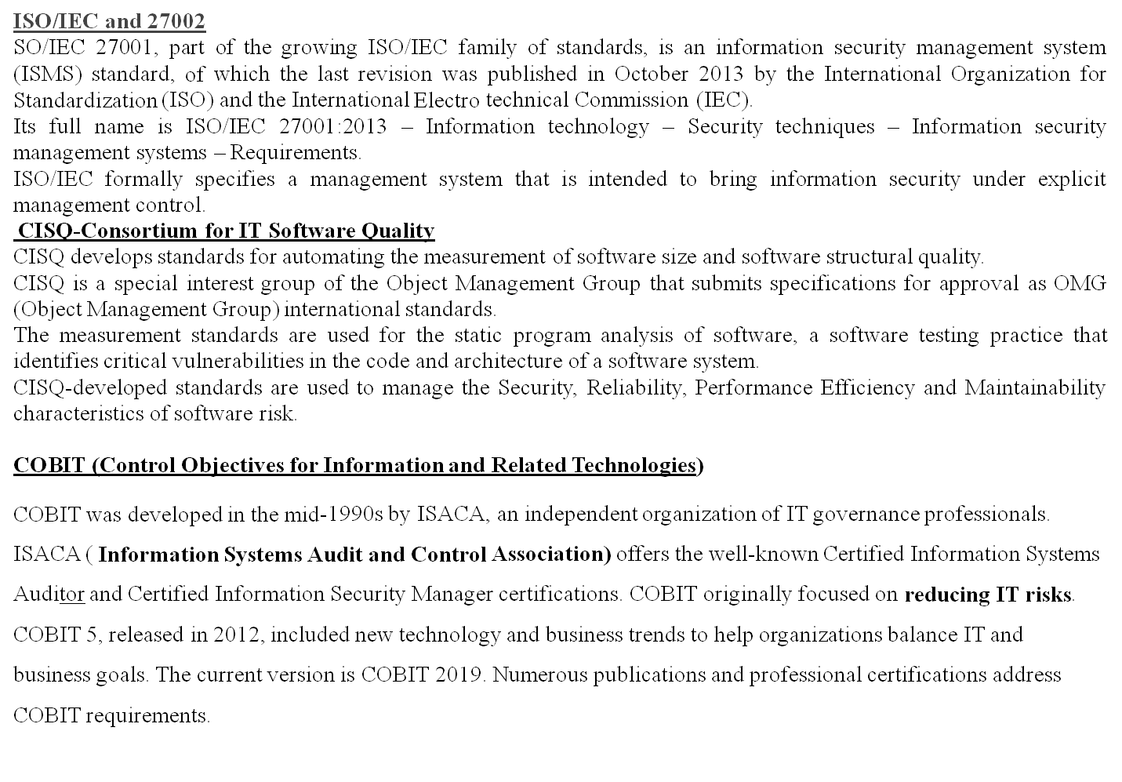
Cyber Security Standards

Slide 6
Risk Assessment and Management
Cyber security risk assessment is the process of identifying, analyzing and evaluating risk. It helps to ensure that the cyber security controls you choose are appropriate to the risks your organization faces.
Example cyber risks : Data leaks, phishing, malware, Ransomware, insider threats, cyber attacks
How to perform a cyber security risk assessment:
It can be split into many parts, but the 5 main steps are: scoping, risk identification, risk analysis, risk evaluation, and documentation.
Step-1: Determine the scope of the risk assessment:
A risk assessment starts by deciding what is in scope of the assessment. It could be the entire organization, but this is usually too big an undertaking, so it is more likely to be a business unit, location or a specific aspect of the business, such as payment processing or a web application.
Step 2: How to identify cyber security risks:
2.1 Identify assets
You can't protect what you don't know, so the next task is to identify and create an inventory of all physical and logical assets that are within the scope of the risk assessment.
2.2 Identify threats
Threats are the tactics, techniques, and methods used by threat actors that have the potential to cause harm to an organization's assets.

Slide 7
Risk Assessment and Management
2.3 Identify what could go wrong
This task involves specifying the consequences of an identified threat exploiting a vulnerability to attack an in-scope asset. For example:
Threat: An attacker performs an SQL injection on an
Vulnerability: unpatched
Asset: web server
Consequence: to steal customers' private data.
Step 3: Analyze risks and determine potential impact
Now it is time to determine the likelihood of the risk scenarios documented in Step 2 actually occurring, and the impact on the organization if it did happen. In a cyber security risk assessment, risk likelihood -- the probability that a given threat is capable of exploiting a given vulnerability -- should be determined based on the discoverability, exploitability and reproducibility of threats and vulnerabilities rather than historical occurrences.
Step 4: Determine and prioritize risks
Using a risk matrix where the risk level is "Likelihood times Impact," each risk scenario can be classified. If the risk of a SQL injection attack were considered "Likely" or "Highly Likely" our example risk scenario would be classified as "Very High."

Slide 8
Risk Assessment and Management
Any scenario that is above the agreed-upon tolerance level should be prioritized for treatment to bring it within the organization's risk tolerance level. There are three ways of doing this:
Avoid. If the risk outweighs the benefits, discontinuing an activity may be the best course of action if it means no longer being exposed to it.
Transfer. Share a portion of the risk with other parties through cyber insurance or outsourcing certain operations to third parties.
Mitigate. Deploy security controls and other measures to reduce the Likelihood and/or Impact and therefore the risk level.
Step 5: Document all risks
It's important to document all identified risk scenarios in a risk register. This should be regularly reviewed and updated to ensure that management always has an up-to-date account of its cyber security risks. It should include:
Risk scenario , Identification date, Existing security controls
Current risk level , Treatment plan -- the planned activities and timeline to bring the risk within an acceptable risk tolerance level
Progress status -- the status of implementing the treatment plan
Residual risk -- the risk level after the treatment plan is implemented
Risk owner -- the individual or group responsible for ensuring that the residual risks remain within the tolerance level

Slide 9
Risk Assessment and Management
ISO 27001 and Cyber risks:
The International standard ISO/IEC 27001:2013 provides the specification for a best practice ISMS(IS management system) a risk based approach to IS risk management that address people, process, and technology
Clause 6.1.2 the standard sets out the requirements of the IS risk assessment process. Organizations must:
Establish and maintain specific IS risk criteria
Ensure that repeated risk assessments produce constant, valid and comparable results.
Identify risk associated with the loss of confidentiality, integrity, and availability for information within the scope of the ISMS and identify the owner of the risk, and
Analyze and evaluate IS risks, according to the criteria established earlier
It is essential that organizations retain documented information about the IS risk assessment process, so that they can demonstrate that they comply with these requirements

Slide 10
Risk Assessment and Management
IT Governance cyber risk assessment service:
Our team of qualified cyber security advisers will provide business-driven consultation on the overall process of assessing information risk. They will offer support, guidance, and advice in the following areas:
Identifying the assets that require protection.
Identifying relevant threats & weaknesses.
Identifying exploitable vulnerabilities.
Assessing level of threat posed by threat agents.
Determining the business impact of risk being realized.
Producing a security risk assessment.
Advising on a risk acceptance threshold or level of acceptance
Advising on a suitable control implementation

Slide 11
Asset Classification
What’s Asset Classification? :
Do you know what and where critical assets in your organization are?
Do you know their value?
What about the impact of their disclosure, corruption or loss?
Organizations depend on critical assets to operate and therefore require having a distinct view of assets throughout its lifecycle. Asset classification is the process for determining the critical assets and the required control to protect it according to its sensitivity. The process can be applied to any asset that has value, including business processes and environments. Since not all assets have the same value or importance, different classification level may apply to different assets. A classification schema should be established and applied throughout the organization based on the confidentiality of each asset.
Why Asset Classification?: Business and financial tasks are not exposed to unacceptable risk; why Should IT be? Organizations are keen on assessing risks when it comes to financial and or strategic task in order to maximize gain, enhance market share and reduce risk. Despite these tasks are highly dependent on technology, yet IT risks are commonly ignored, jeopardizing accuracy, integrity, confidentiality and availability.

Slide 12
Asset Classification
Asset classification is an important first step in the process of risk assessment. However, we understand the challenges of successfully preforming this task; business owners commonly believe that their assets are the most important but this view may not be shared with C level members.
Creating the right balance between the different assets across the organization is a key for effective protection. This will require a good understanding of business goals and objectives – designing the link between assets and crucial business activities.
Asset classification is a process for systematically segregating the assets into various groups, based on the nature of the assets, by applying the accounting rules to make proper accounting under each group. The groups are later consolidated at the financial statement level to report.

Slide 13
Asset Classification
All the Company's information, data and communication must be classified strictly according to its level of confidentiality, sensitivity, value and criticality. Information may be classified as HIGHLY RESTRICTED, CONFIDENTIAL, INTERNAL USE ONLY, and PUBLIC.
HIGHLY RESTRICTED: This classification label applies to the most private or otherwise sensitive information of the Company. Information under this classification shall be strictly monitored and controlled at all times. (e.g. merger and acquisition documents, corporate level strategic plans, litigation strategy memos, reports on breakthrough new product research, and Trade Secrets such as certain computer programs)
CONFIDENTIAL: This classification label applies to Company information, which is private or otherwise sensitive in nature and shall be restricted to those with a legitimate business need for access. (e.g. employee performance evaluations, customer transaction data, strategic alliance agreements, unpublished internally generated market research, computer passwords, identity token personal identification numbers (PINs), and internal audit reports.
INTERNAL USE ONLY: This classification label applies to information intended for use within the Company, and in some cases within affiliated organizations, such as business partners of the Company. Assets of this type are widely-distributed within the Company and may be distributed within Company without permission from the information asset owner. (e.g. telephone directory, dial-up computer access numbers, new employee training materials, and internal policy manuals.
PUBLIC: This classification applies to information that has been explicitly approved by the Company’s management for release to the public. Assets of this type may be circulated without potential harm. (e.g. product and service brochures, advertisements, job opening announcements, and press releases.)

Slide 14
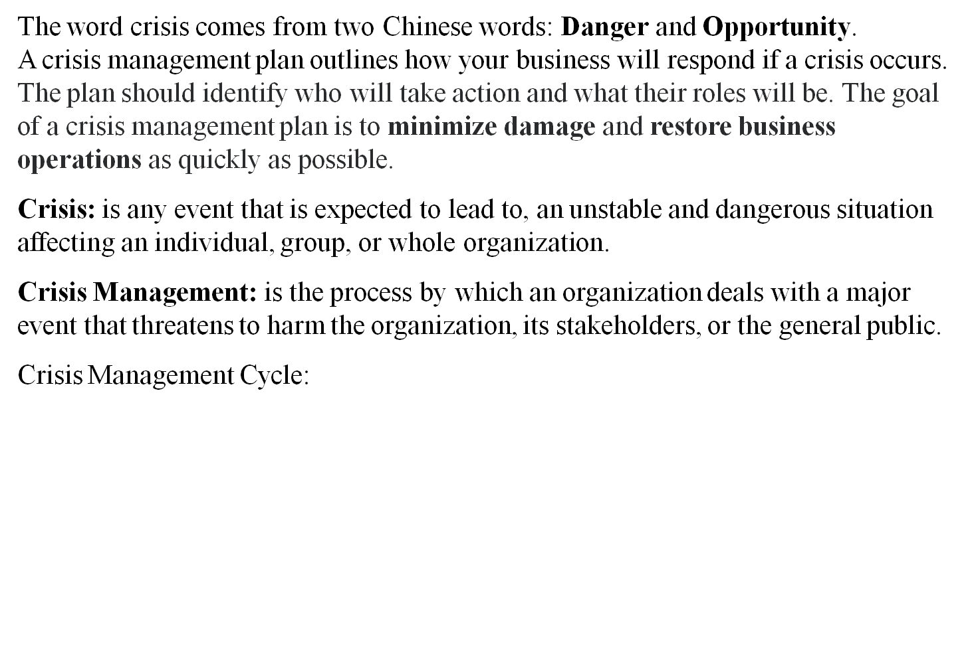
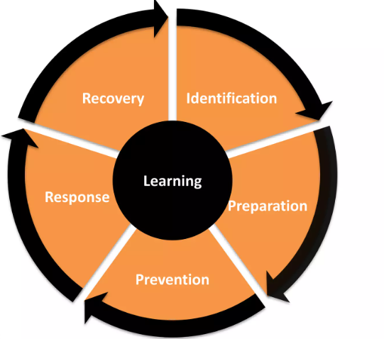
Crisis Management Plan

Slide 15
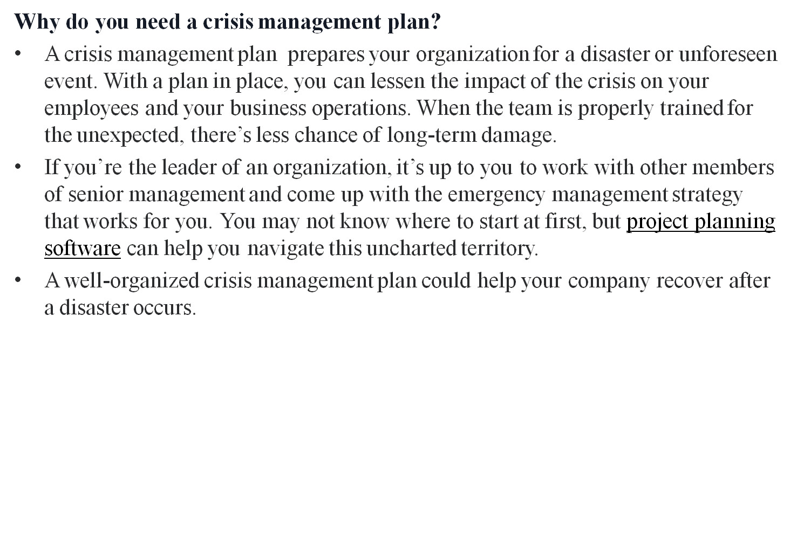
Crisis Management Plan

Slide 16
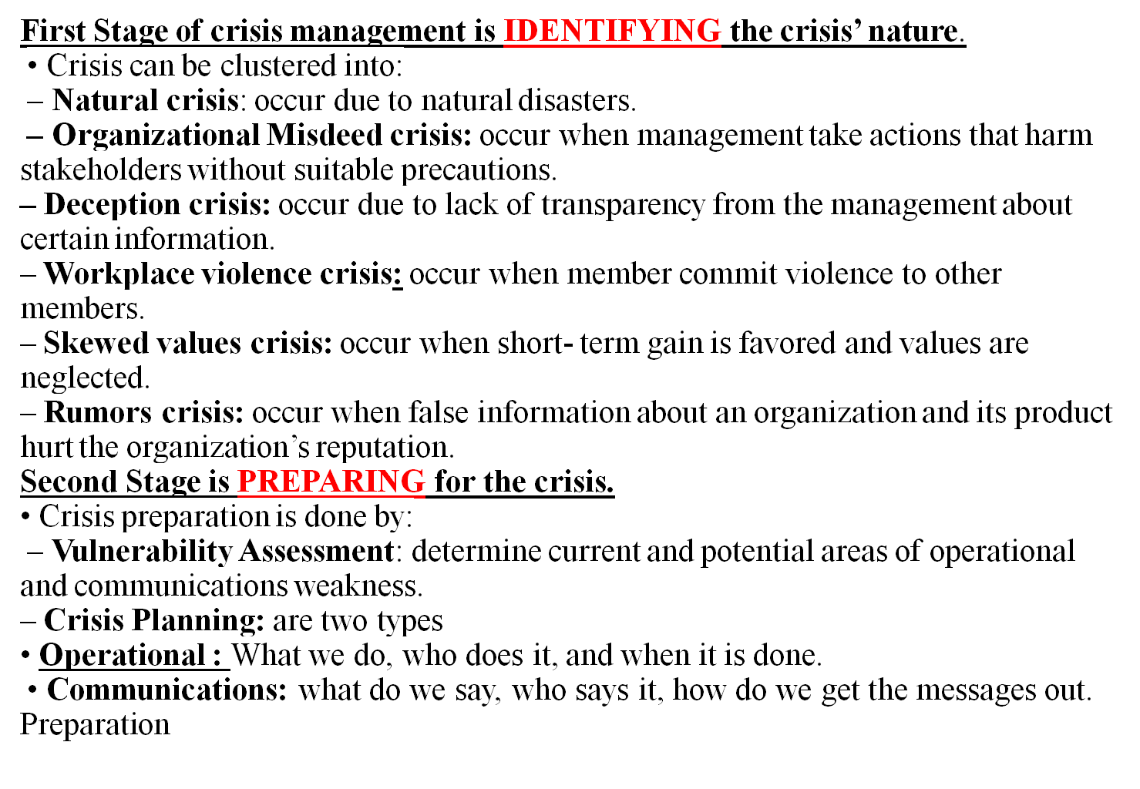
Crisis Management Plan

Slide 17
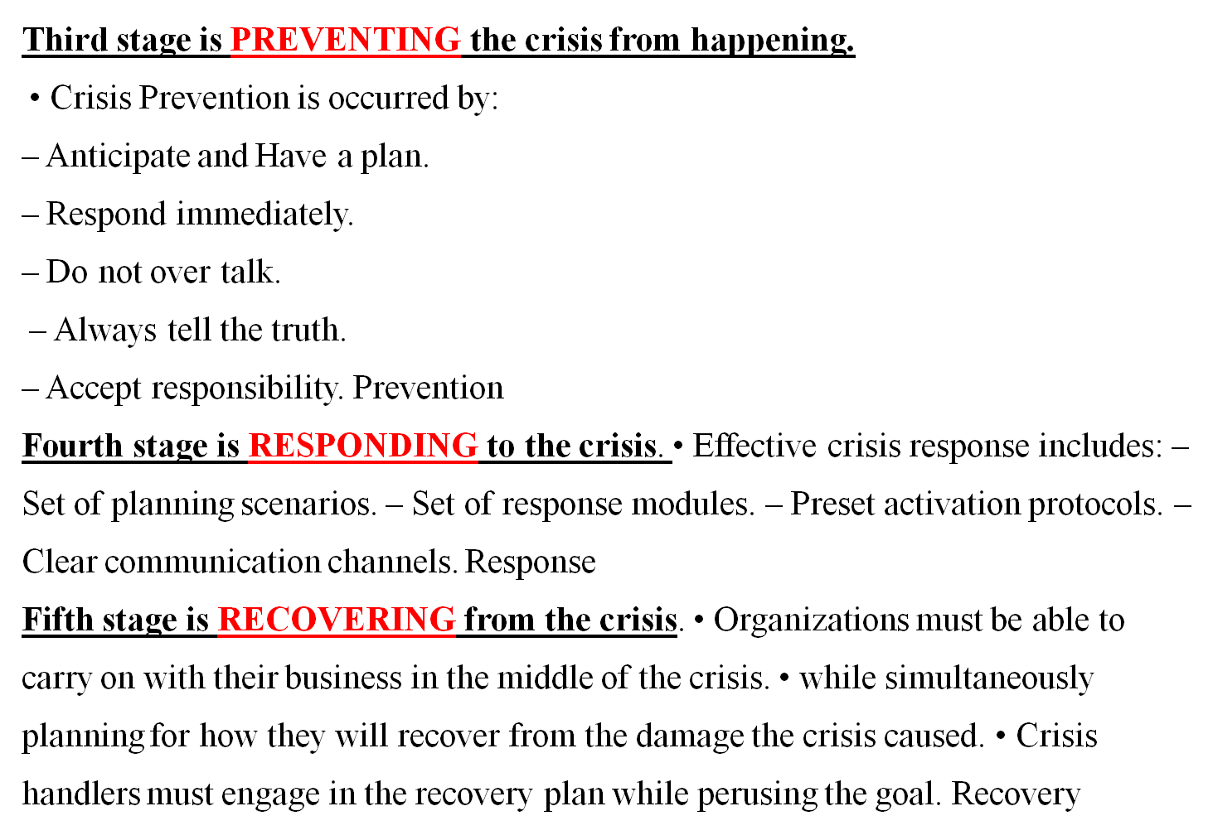
Crisis Management Plan

Slide 18
Resources Recovery Strategy
A cyber recovery system requires a cyber vault that is both physically and virtually isolated and functions as a data center. It is automated to control the gap between a disaster recovery system and a cyber recovery system by leaving the link open or closing it when necessary.
The vault storage backup system is immutable, meaning that the data cannot be modified or compromised by crypto-locking, leaving it safe for you to restore once your network is clean.
Cyber recovery planning can be complex – but it is crucial. Follow the five steps below to strengthen your cyber recovery strategy:
Go Beyond Disaster Recovery
First, recognize that cyber recovery planning is a specialized scenario that most disaster recovery solutions do not adequately cover. Cyber recovery is needed in order to protect your most essential data, minimize the risk of service disruption, and help your business remain resilient if faced with an attack.
Prioritize Your Data
Understanding what data needs protecting is a critical step, as it will determine how much space and time will be needed for the solution, which drives a lot of the cost. When prioritizing the data, businesses must also consider on-premises and public cloud data.

Slide 19
Resources Recovery Strategy
Leverage Air-Gapped Cyber Recovery Vaults and Immutable Copies
An air-gapped and secure cyber recovery vault provides both physical and logical isolation of critical data, ensuring that cyber criminals cannot get to “known good” copies. An immutable copy ensures no changes can be made to the data. The air-gapped environment can be used to run integrity checks on the data and can be used as an isolated recovery environment (IRE).
Restore Your Data Efficiently
Not all cyber recovery solutions support the same recovery paths. Some support recovering back to your on-premises environment, while others support recovery to a public cloud. A cyber recovery vault enabled for multi-cloud recovery allows you to choose from infinite resources, from across public clouds, for immediate restoration of your data
Remember That You’re Not Alone
As cyber recovery strategies become a standard, a growing number of valuable resources can help your organization. For example, the NIST Cybersecurity Framework provides guidance about identifying data, protecting it, detecting risks, responding to an attack, and recovering from it. Similarly, analyst firm Gartner’s How to Prepare for Ransomware Attacks provides steps for pre- and post-incident care to help guard against the financial and reputational impacts of an attack.

Slide 20
Resources Recovery Strategy
Cyber attacks can be devastating for a business big and small. The latest data breach report by IBM indicates that the average cost of a data breach in 2021 rose to the incredible figure of $4.24 million per incident, the highest average cost in the history of this report.
Elements of a Cyber security Disaster Recovery Plan
Before you begin the necessary steps for creating a disaster recovery plan, you need to consider what elements you need to include in order for it to be most successful. Keep in mind that the end goal of your cybersecurity disaster recovery plan is to make sure that your IT infrastructure is functional and secure.
At a minimum, your DRP should include the following elements:
A clear owner
Involvement from members throughout your organization
Clear paths for communication
Simple methods for execution
A comprehensive, multi-layered approach
Regular practice and continuous updates

Slide 21
Security Testing
What is Security Testing?
Security Testing is a type of Software Testing that uncovers vulnerabilities, threats, risks in a software application and prevents malicious attacks from intruders. The purpose of Security Tests is to identify all possible loopholes and weaknesses of the software system which might result in a loss of information, revenue, repute at the hands of the employees or outsiders of the Organization.
Why Security Testing is Important?
The main goal of Security Testing is to identify the threats in the system and measure its potential vulnerabilities, so the threats can be encountered and the system does not stop functioning or can not be exploited. It also helps in detecting all possible security risks in the system and helps developers to fix the problems through coding.

Slide 22
Security Testing
Types of Security Testing:
1.Vulnerability Scanning: This is done through automated software to scan a system against known vulnerability signatures.
2.Security Scanning: It involves identifying network and system weaknesses, and later provides solutions for reducing these risks. This scanning can be performed for both Manual and Automated scanning.
3.Penetration testing: This kind of testing simulates an attack from a malicious hacker. This testing involves analysis of a particular system to check for potential vulnerabilities to an external hacking attempt.
4.Risk Assessment: This testing involves analysis of security risks observed in the organization. Risks are classified as Low, Medium and High. This testing recommends controls and measures to reduce the risk.
5.Security Auditing: This is an internal inspection of Applications and Operating systems for security flaws. An audit can also be done via line by line inspection of code
6.Ethical hacking: It’s hacking an Organization Software systems. Unlike malicious hackers, who steal for their own gains, the intent is to expose security flaws in the system.
7.Posture Assessment: This combines Security scanning, Ethical Hacking and Risk Assessments to show an overall security posture of an organization.

Slide 23
Security Testing
Example Test Scenarios for Security Testing: Sample Test scenarios to give you a glimpse of security test cases –
A password should be in encrypted format
Application or System should not allow invalid users
Check cookies and session time for application
For financial sites, the Browser back button should not work.
Methodologies/ Approach / Techniques for Security Testing
In security testing, different methodologies are followed, and they are as follows: Tiger Box: This hacking is usually done on a laptop which has a collection of OSs and hacking tools. This testing helps penetration testers and security testers to conduct vulnerabilities assessment and attacks.
Black Box: Tester is authorized to do testing on everything about the network topology and the technology.
Grey Box: Partial information is given to the tester about the system, and it is a hybrid of white and black box models.

Slide 24
Security Testing
Security Testing Tool:
1)Acunetix: Intuitive and easy to use, Acunetix by Invicti helps small to medium-sized organizations ensure their web applications are secure from costly data breaches. It does so by detecting a wide range of web security issues and helping security and development professionals act fast to resolve them.
2) Intruder: Intruder is a powerful, automated penetration testing tool that discovers security weaknesses across your IT environment. Offering industry-leading security checks, continuous monitoring and an easy-to-use platform, Intruder keeps businesses of all sizes safe from hackers.
3) Owasp: The Open Web Application Security Project (OWASP) is a worldwide non-profit organization focused on improving the security of software. The project has multiple tools to pen test various software environments and protocols. Flagship tools of the project include 1Zed Attack Proxy (ZAP – an integrated penetration testing tool) 2OWASP Dependency Check (it scans for project dependencies and checks against know vulnerabilities) 3OWASP Web Testing Environment Project (collection of security tools and documentation)
4) WireShark: Wireshark is a network analysis tool previously known as Ethereal. It captures packet in real time and display them in human readable format. Basically, it is a network packet analyzer which provides the minute details about your network protocols, decryption, packet information, etc. It is an open source and can be used on Linux, Windows, OS X, Solaris, NetBSD, FreeBSD and many other systems. The information that is retrieved via this tool can be viewed through a GUI or the TTY mode TShark Utility.
5) W3af: w3af is a web application attack and audit framework. It has three types of plugins; discovery, audit and attack that communicate with each other for any vulnerabilities in site, for example a discovery plugin in w3af looks for different url’s to test for vulnerabilities and forward it to the audit plugin which then uses these URL’s to search for vulnerabilities.

Slide 25
International Standards
To make Cyber Security measures explicit, the written norms are required. These norms are known as standards.
The standards may involve methods, guidelines, reference framework etc.
The stands include requirements for developing Information Security management System (ISMS), implementing security controls, and conducting risk assessments.
The goal of security standards is to improve the security of IT systems, network and critical infrastructure.
Security standards are provided for all the organizations regardless of the size or the industry and sector in which they operate.
ISO :
It stands for International Organization for Standardization. International standards make things to work.
These standards provide world class specifications for products, services, and computers to ensure quality, safety and efficiency.
ISO standard officially established on 23/02/1947. it is an independent, non-governmental international organization.

Slide 26
International Standards
Today it has a membership of 162 national standard bodies, and 784 technical committees & sub-committees to take care of standard development.
ISO has published over 22336 international standards and its related documents which covers almost every industry from IT to agriculture & Healthcare.
a) ISO 27000 series:
it is the family of ISO standard which is developed by the ISO and the IEC(International Electro-technical Commission) to provide globally recognized framework for best IT management.
The need of ISO 27000 series arise because of risk of cyber attacks which the organization face.
The ISO 27000 series categorized into many types they are:
i) ISO 27001: this standard allows us to prove clients & stakeholders for any organization to managing the best security of their confidential data and information. This standard involve a process-based approach establishing , implementing, operations , monitoring and maintaining and improve our ISMS.
ii) ISO 27000: this standard provides an explanation of terminologies used in ISO 27001

Slide 27
International Standards
iii) ISO 27002: This standard provides guidelines for organizational IS standards and IS management practices. IT includes selection, implementation, operating and management of controls taking into consideration of organizational IS risk environment.
iii) ISO 27005: This standard supports general concepts specification 27001. It is designed to provide the guidelines for implementation of IS based on a risk management approach.
To completely understand the ISO/IEC 27005, the knowledge of the concepts, models, processes and terminologies described in ISO/IEC 27001, and ISO/IEC 27002 is required.
iii) ISO 27032: it is the international standard which focuses explicitly on cyber security. This standard includes guidelines for protecting the information beyond the borders of an organization such as in collaborations, partnerships or other information sharing arrangements with clients and suppliers.

Slide 28
Analysis and Logging
What is Security Logging and Analysis or Monitoring?
Security event logging and analysis are two parts of a singular process that is integral to the maintenance of a secure infrastructure. Every activity on your environment, from emails to logins to firewall updates, is considered a security event. All of these events are, (or should be,) logged in order to keep tabs on everything that’s happening in your technology landscape.
When it comes to monitoring those logs, organizations will examine the electronic audit log files of confidential information for signs of unauthorized activities.
If unauthorized activities (or attempts thereof) are found, the data will be moved to a central database for additional investigations and necessary action.
In a time where digital threats are widespread and ever-changing, the data gleaned from these log files is vital in keeping the infrastructure agile and responsive.

Slide 29
Analysis and Logging
How does it work?
Security event logging and monitoring can only work when it is part of an effective data collection and analysis process. Security logs often contain a massive swath of data. So much of it that it will be near impossible for a human eye to effectively identify threats within it.
This means there will often be missed security incidents, false flags, and duplicate information.
This means that the key to effective Security Logging and Monitoring processes is the ability to weed out unnecessary information. To focus solely on critical events that could compromise the integrity and/or availability of the confidential information.

Slide 30
Analysis and Logging
An effective log data collection and analysis process should incorporate tools to quickly and easily review audit logs for evidence of critical events like:
Reconnaissance against your environment – where adversaries perform research on your environment… that could make you their next target.
Weaponization – an intrusion within your environment where adversaries have decided to take action against your network and IT systems.
Delivery – the manifestation of an exploit against a vulnerability within your network or IT systems.
Installation of malware – observed when an adversary has modified native functionality in your environment to maintain persistence.
Command and Control – when criminal hackers gain access to your server and systems and effectively take control of your environment.
Action begins – determining what the adversary actions and maintaining visibility to them at all times are critical, you want to understand their desired goal and prevent the successful intrusion.

Slide 31
Analysis and Logging
Benefits of security Analyzing and Logging:
Security logging and analyzing for the detection of security breaches
Most enterprises are afflicted by different types of security events. They can help guard against malicious external threats while also guarding against internal misuses of information. They can be detected in real-time to facilitate fast intervention while also contributing to your long-term strategy.
▪ Security logging and analyzing for event reconstruction
Even if a breach should occur, audit trails can facilitate a reconstruction of the events leading up to the incursion. CIOs will have a clear idea of how the breach occurred and how to rectify vulnerabilities.
Security logging and analyzing for faster recovery
Downtime is the bane of businesses. Audit logs can create a fast and effective recovery process.They can help to reconstruct data files which were lost or corrupted by reverse engineering from the changes recorded in the logs.

Slide 32
Security Certification
A certification degree will lead us to our dream job. At some point in our professional life, and IT security certification from a renowned third-party organization may be necessary.
Cyber Security Certifications are available in different shapes and subjects such as forensic to intrusion to ethical hacking. They are typically administrated by independent accredited organizations such as CompTIA, EC Council, GIAC, ISACA, and (ISC) 2
The certification program is divided into three categories in these accredited organization:
The basic entry-level certification is meant to educate you in- foundation principles, best practices, important tools, latest technologies, etc.
The intermediate and expert-level certifications presume that we have extensive job experience and a detailed grasp of the subject matter.

Slide 33
Security Certification
According to the topic or level:
The employees of the organizations mostly acquire IT security certifications.
The training and the final exam have consisted of the credential process.
It must be renewed periodically, such as for every 3-4 years.
To be reaccredited, we'll need continuing education credits and the ability to pass the current exam.
Costs for Cyber Security Certification:
When we want to get the cyber security certification, nothing can stop us from getting our dream job if we have the skills.
We cannot here lie about the expense of the certification. The cyber security certification can be expensive and time-consuming.
Any entry-level certification takes three-nine months to complete and costs us back $300-$600 for the examination. This certification leads to promotion, better job prospects and raise. It will help you to get a hike in your salary.

Slide 34
Security Certification
Which Certification to Choose
When you want to enroll in entry-level training, you may start by considering the given certification:
CompTIA Security+
GSEC: GIAC Security Essential Certification
SSCP: System Security Certified Practitioner
Or you can select security+, which is one of the most well-known beginners' certification. But these certifications will depend on your level of expertise, and action depends upon your level of expertise and your field of interest.
Some of the popular certification:
CISSP: Certified Information System Security Professional is a high-level certification that is focused on security policy and management. It is the most frequently acquired certification in the business by the individuals. It is one of the top-paying IT security certifications.
CISA: Certified Information System Auditor has been designed for the professionals who audit, control, monitor and assess information technology and business systems.

Slide 35
security Certification
CISM: Certified Information Security Manager has been geared towards people in managerial positions such as the CIO of IT security.
GCIH: GIAC Certified Incident Handler is for the incident handlers responsible for detecting, responding to and resolving computer security incidents.
CEH: Certified Ethical Hacker has been discussed among white hat hackers and penetration testers.
OSCP: Offensive Security Certified Professional has been designed for the penetration testers and includes a rigorous 24-hour certification exam.

